Slide 1

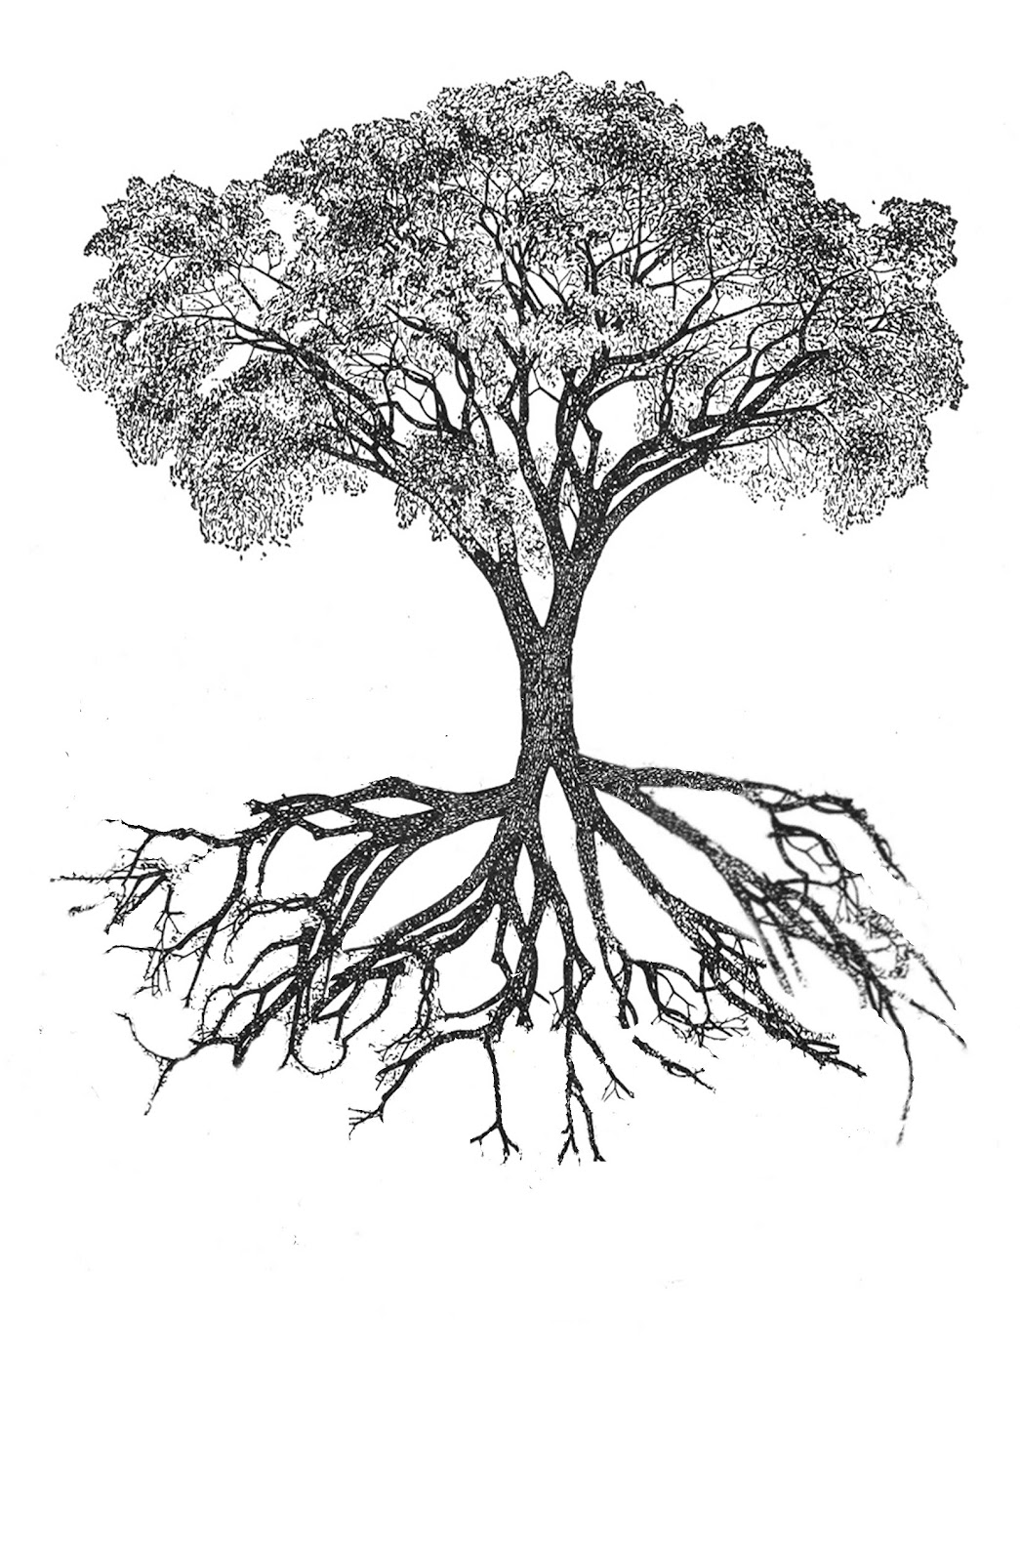

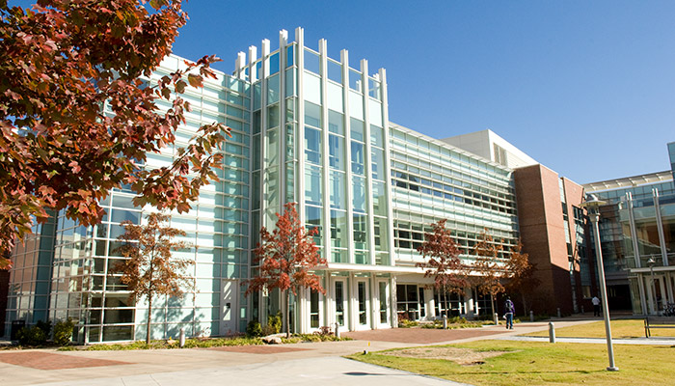
The Hourglass Effect in Hierarchical Dependency Networks
Constantine Dovrolis
School of Computer Science, Georgia Tech

Slide 2
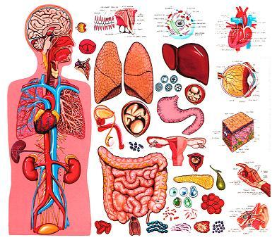

How does nature and technology manage complexity?
1. Modularity
The system is composed of autonomous parts
Each part provides a function
A part’s function does not change when connected with other parts

Slide 3


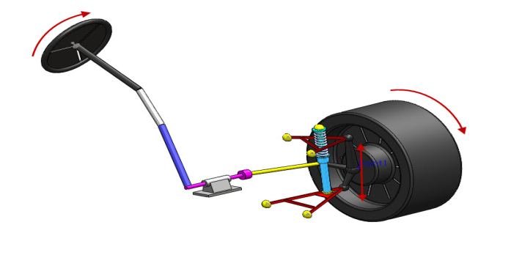
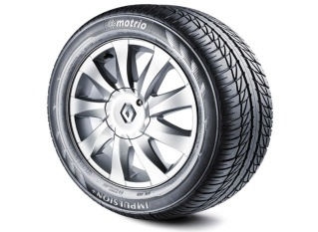
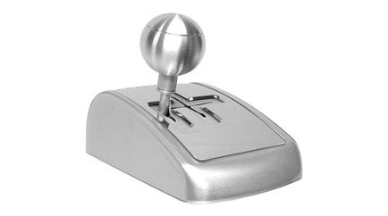
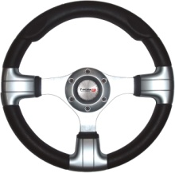
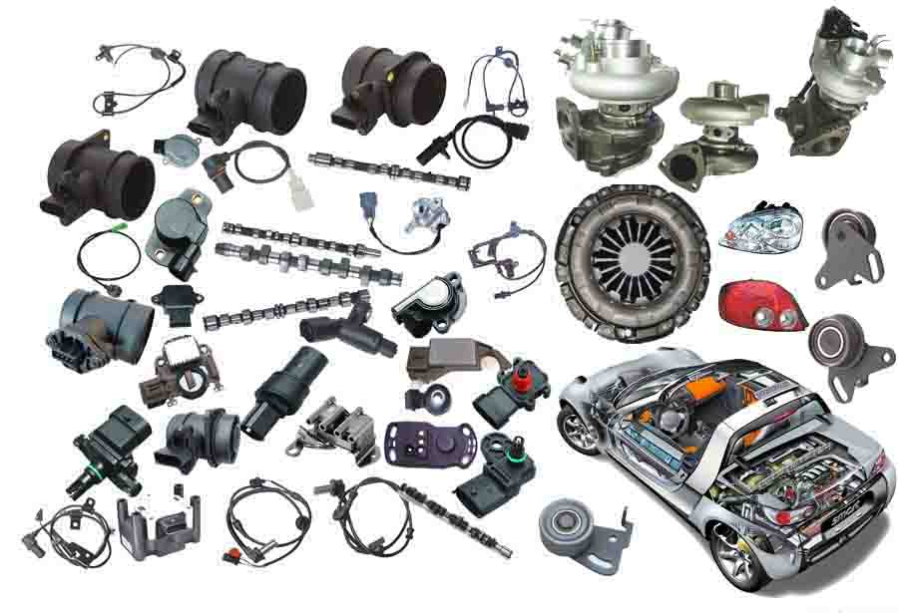
How does nature and technology manage complexity?
2. Hierarchy
Modules are placed in layers – or in some dependency order
Each layer provides a “function” to next layer
Most general-purpose modules at first layer
Most complex modules at last layer

Slide 4
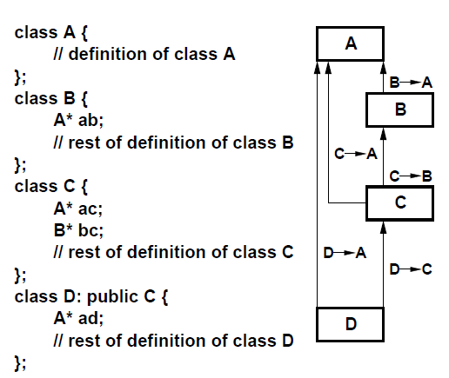
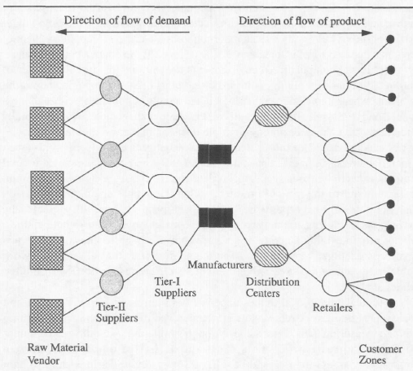
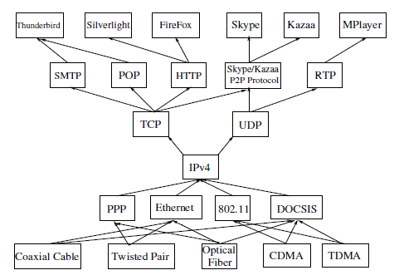
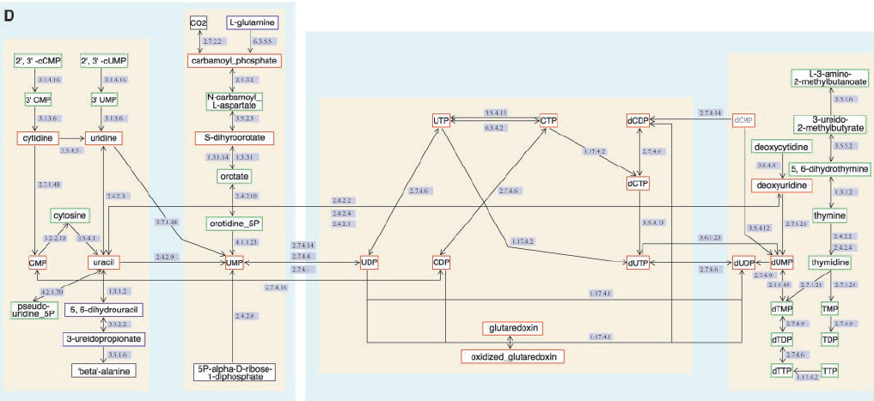
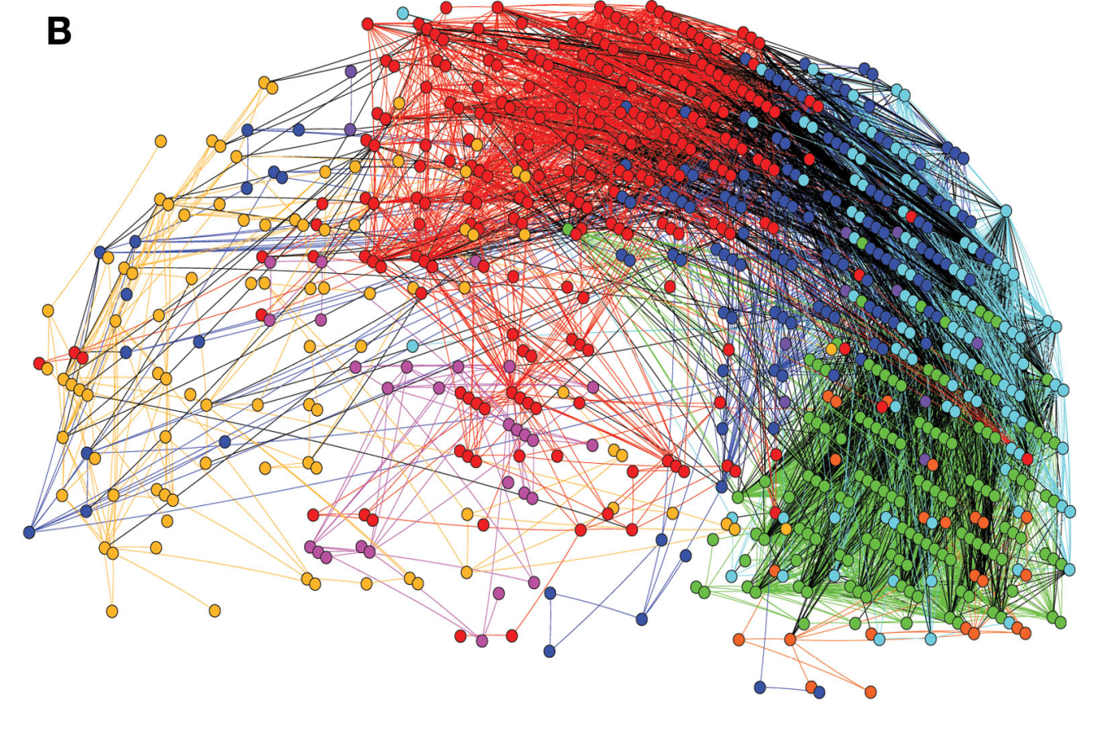
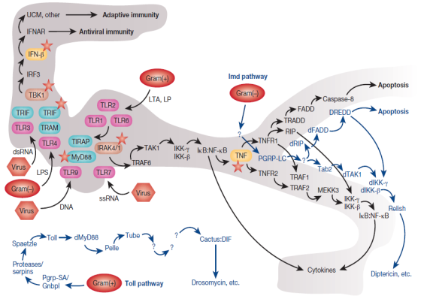
Software systems
Hierarchical modularity is everywhere
Supply chain networks
Internet protocol stack
Metabolic networks
Brain networks
Innate immune system
C.R.Myers. Software systems as complex networks: Structure, function, and evolvability of software collaboration graphs. Physical Review E, 2003
J.M. Swaminathan, S.F. Smith, and N.M. Sadeh. Modeling supply chain dynamics: A multiagent approach*. Decision Sciences, 29(3):607–632, 1998.
S. Akhshabi and C. Dovrolis. The Evolution of Layered Protocol Stacks Leads to an Hourglass-Shaped Architecture. ACM SIGCOMM, 2011.
Hierarchical Organization of Modularity in Metabolic Networks, E. Ravasz, et al., Science 297, 1551 (2002);
D. Meunier et. al. . Hierarchical modularity in human brain functional networks. Frontiers in neuroinformatics, 3, 2009.
B. Beutler. Inferences, Questions and Possibilities in Toll-like Receptor Signalling. Nature,, 2004.

Slide 5
Our main thesis: natural & technological hierarchical systems evolve towards an hourglass architecture when there is an incentive to maximize reuse
outputs
Hourglass waist:
a small number of modules of intermediate complexity that are highly important and conserved
Increasing Complexity
inputs

Slide 6
How to represent a hierarchically modular system with a
network?

Slide 7
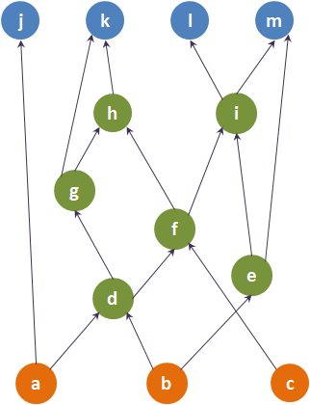
Dependency networks
Sources: orange nodes
Intermediates: green nodes
Targets: blue nodes
Directed & Acyclic Graph (DAG)
Key concept: Source-Target (ST) dependency paths
Sources & Targets may be given or chosen based on in/out degree

Slide 8
Hourglass architecture in layered dependency networks
j
k
l
m
g
h
i
f
d
e
a
b
c

Slide 9
Internet protocol stack (Akhshabi & Dovrolis, ACM SIGCOMM’11)
Firefox
Silverlight
Thunderbird
MPlayer
…
HTTP
SMTP
RTP
…
TCP
UDP
IPv4
PPP
Ethernet
…
Optical Fiber
Twisted Pair
Coaxial Cable
…

Slide 10
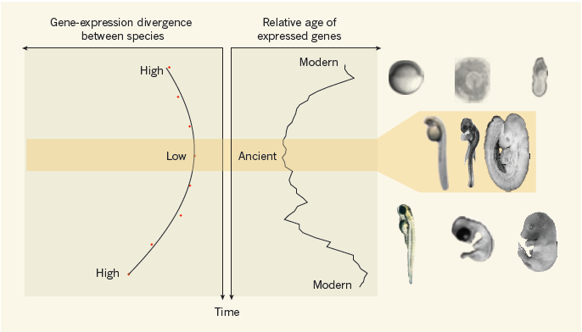
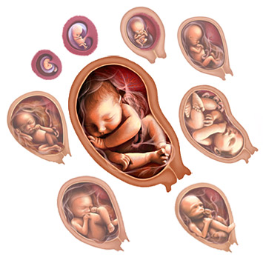

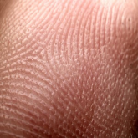
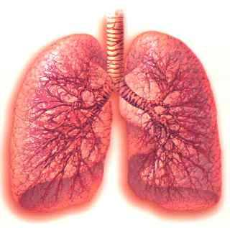
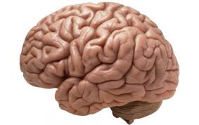
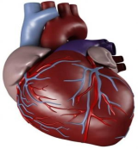
Developmental hourglass
Upstream regulators of g,
g
Regulatory genes
Downstream regulators of g,
Developmental time
Akhshabi, Sarda, Yi, Dovrolis, “An explanatory evo-devo model for the developmental hourglass”, F1000, 2014

Slide 11
What about general (non-layered) dependency nets?
j
k
l
m
h
i
g
f
d
e
a
b
c

Slide 12
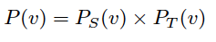
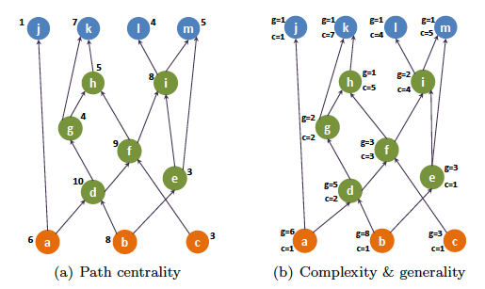
Path centrality
The path centrality P(v) of node v is the number of
ST-paths that traverse v
= Complexity * Generality

Slide 13
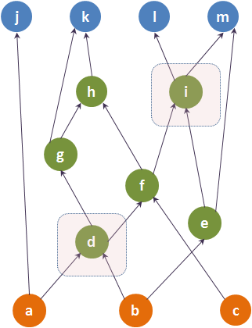
τ-Core of a dependency network
τ-Core problem: compute smallest set of nodes that cover at least a fraction τ (<1) of all ST dependency paths

Slide 14
τ-Core of a dependency network
τ-Core problem is NP-Complete
Based on a reduction from the k-Group Centrality Maximization problem in:
“A framework for the evaluation and management of network centrality” by V.Ishakian et al., SDM 2011

Slide 15
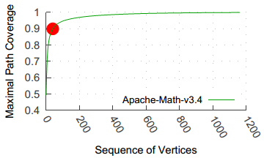
Algorithm for τ-Core computation
Greedy heuristic (approximation bound: 1-1/e ~ 0.63)
Select core nodes sequentially, based on maximal path coverage
Recompute path coverage in each iteration

Slide 16
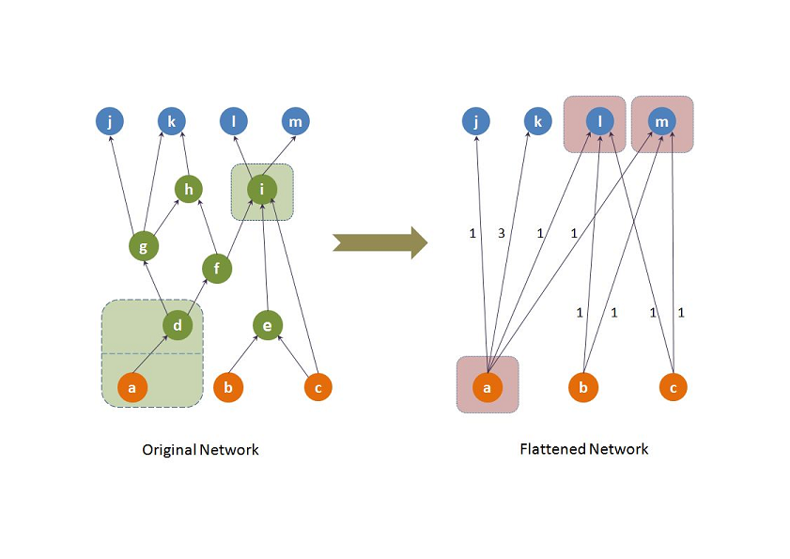
How to quantify the hourglass property?
Flat network maintains number of source-target paths as original network, without intermediate nodes
We also compute the core of flat network

Slide 17
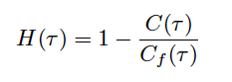
Hourglass score H(τ)

Slide 18
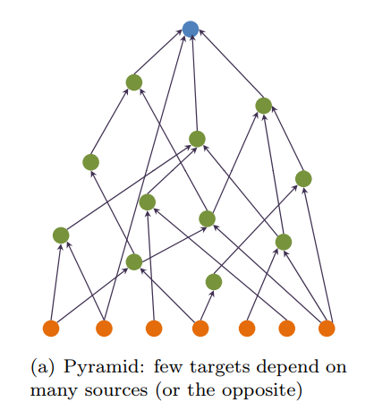
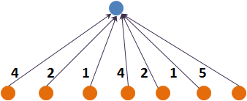
Example-1: “Pyramid-like”
τ = 0.9
Core size: 1
Flat core size: 1
H-score: 0

Slide 19
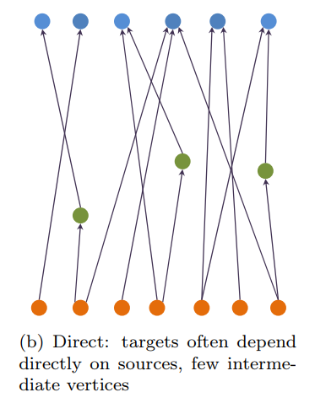
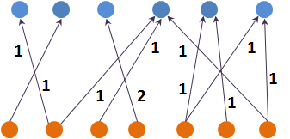
Example-2: “Direct”
τ = 0.9
Core size: 6
Flat core size: 6
H-score: 0

Slide 20
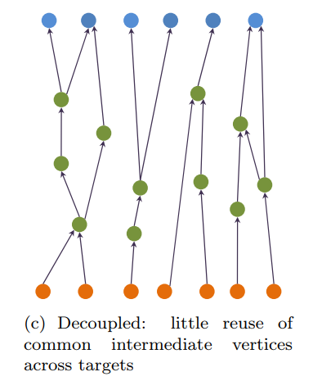
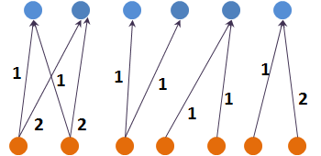
Example-3: “Decoupled”
τ = 0.9
Core size: 4
Flat core size: 5
H-score: 0.2

Slide 21
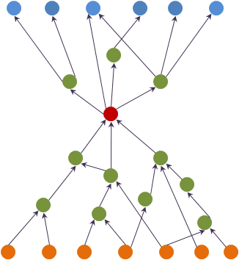
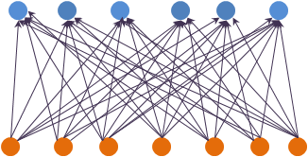
Example-4: “Hourglass”
τ = 0.9
Core size: 1
Flat core size: 7
H-score: 0.86
All ST dependency paths traverse a small set of nodes

Slide 22
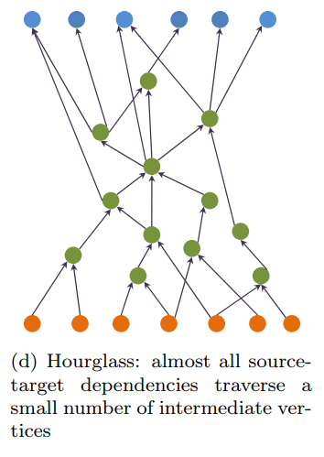
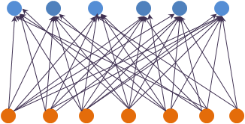
Example-5: “Approx hourglass”
τ = 0.9
Core size: 2
Flat core size: 6
H-score: 0.66

Slide 23
Some results from real dependency networks

Slide 24
OpenSSH
call graph
sftp_server_main
load_server_config
load_server_config
packet_send
0.47
version-5.2:
1400 functions, and 6000 edges
server_loop
0.13
get_remote_ipaddr
0.1
send_status
buffer_append
0.02
0.21
buffer_free
packet_remaining
exit

Slide 25
Metabolic Network of
M. Mulatta (monkey)
3-Oxododecanoyl-CoA
L-Cystathionine
L-Arginine
Citrulline
0.63
Serine
Acetyl-CoA
0.69
920 metabolites, and 1000 interactions
0.25
Pyruvate
0.81
Glyceraldihyde
0.61
PEP
0.65
Formaldehyde
Sulfate
NADP

Slide 26
SCOTUS
citation network for
‘Abortion’ cases
E Enterprise v. Apfel (1998)
Reno v. Bossier Parish (1998)
Gilligan v. Morgan (1973)
Bigelow v. Virginia (1975)
0.01
1500 cases, and 3300 citations
Planned Parenthood v. Casey (1992)
0.37
0.68
Harris v. McRae (1980)
Roe v. Wade (1973)
0.51
0.45
U.S v. Munsingwear (1950)
Katz v. U.S (1967)
Doran v. Salem Inn. (1975)

Slide 27
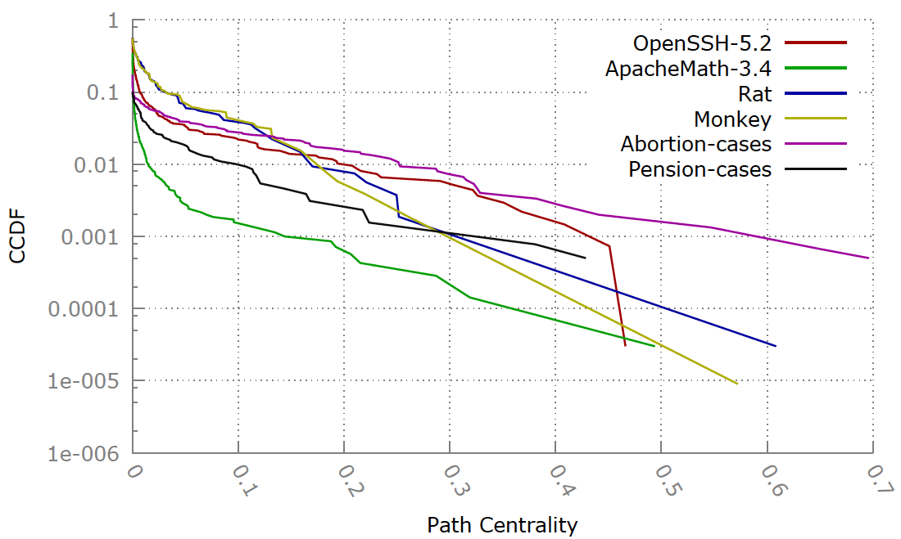
(Normalized) path centrality distribution

Slide 28
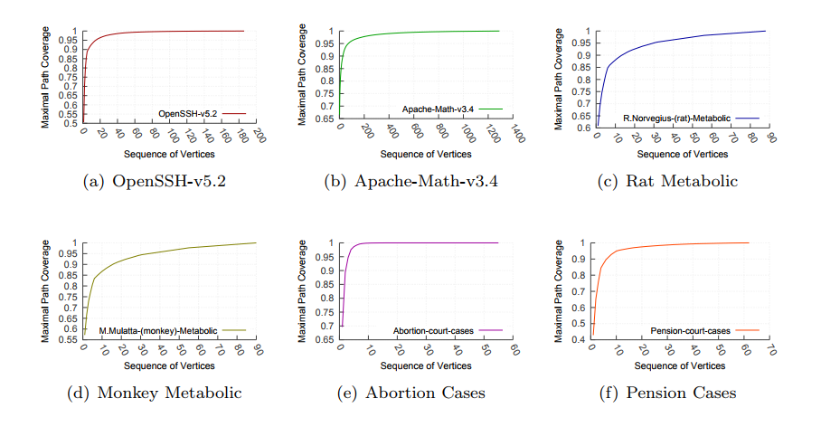

Slide 29
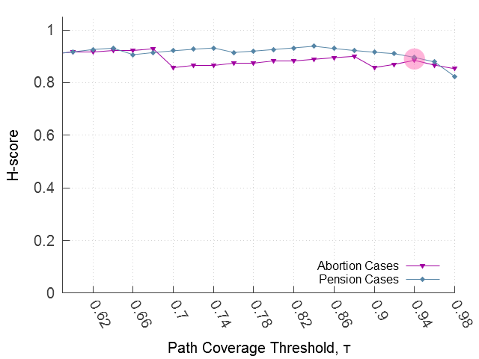

Slide 30
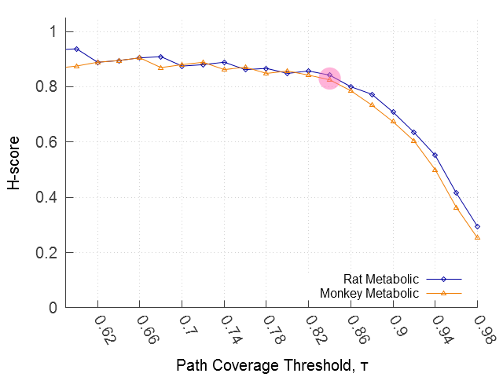

Slide 31
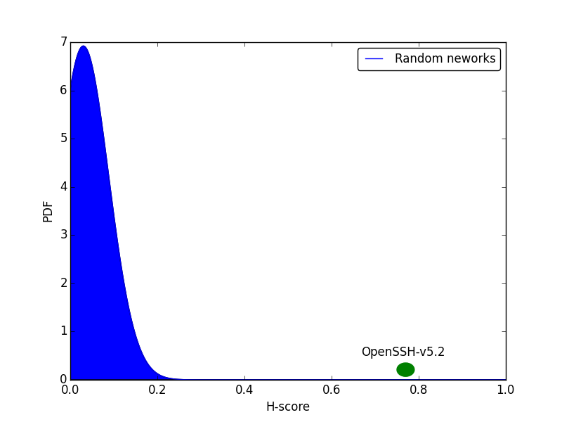
Randomized networks:
preserve in-degree and partial ordering of nodes

Slide 32
Monkey Metabolic Network
Core size: 8, H-Score: 0.81
Top-3 nodes at waist:
Pyruvate
Phosphenol pyruvate
Oxalocetate
Rat Metabolic Network
Core size: 7, H-Score: 0.82
Top-3 nodes at waist:
Pyruvate
Phosphenol pyruvate
Oxalocetate
τ = 85%

Slide 33
SCOTUS Pension Cases
Core size: 11, H-Score: 0.89
Top-3 nodes at waist:
Goldberg vs Kelly (’70)
Allied Steel vs Spannaus (‘78)
LA Water vs Manhart (‘78)
SCOTUS Abortion Cases
Core size: 4, H-Score: 0.86
Top-3 nodes at waist:
Roe vs Wade (‘73)
Bigelow vs Virginia (‘75)
Planned Parenthood vs Casey (‘92)
τ = 95%

Slide 34
SCOTUS Pension cases Comparison with “Landmark cases” (Cornell Law)
Case | CORE Rank | DEGREE Rank | CLOSE/NESS Rank | BETWEEN/NESS Rank | KATZ Rank | PATH CENTRAL Rank | Landmark Case? (5) | K-CORE DECOMP (28)
Goldberg v. Kelly (1970) | 1 | 1 | 1 | 1 | 1 | 1 | y
Allied Structural Steel Co. v. Spannaus (1978) | 2 | 8 | 55 | 3 | 8 | 3 | y | y
City of L.A. Dep't of Water & Power v. Manhart (1978) | 3 | 14 | 43 | 6 | 14 | 6 | y
United States R. Ret. Bd. v. Fritz (1980) | 4 | 5 | 63 | 2 | 5 | 2 | y
Johnson v. Robison (1974) | 5 | 4 | 53 | 4 | 4 | 4
Hishon v. King & Spalding (1984) | 6 | 20 | 141 | 15 | 21 | 16
Helvering v. Davis (1937) | 7 | 14 | 4 | 8 | 15 | 12 | y
United States v. Kokinda (1990) | 8 | 3 | 222 | 9 | 3 | 23
Nollan v. California Coastal Com. (1987) | 9 | 9 | 178 | 10 | 9 | 26
Pension Benefit Guar. Corp. v. LTV Corp. (1990) | 10 | 20 | 131 | 7 | 19 | 13
Plaut v. Spendthrift Farm (1995) | 11 | 6 | 269 | 12 | 6 | 5

Slide 35
SCOTUS Abortion cases Comparison with “Landmark cases” (Cornell Law)
Case | CORE Rank | DEGREE Rank | CLOSE/NESS Rank | BETWEEN/NESS Rank | KATZ Rank | PATH CENTRAL Rank | Landmark Case? (15) | K-CORE DECOMP (25)
Planned Parenthood v. Casey (1992) | 1 | 6 | 834 | 13 | 6 | 1 | y | y
Roe v. Wade (1973) | 2 | 1 | 1 | 2 | 1 | 2 | y | y
Bigelow v. Virginia (1975) | 3 | 12 | 81 | 8 | 12 | 6 | y
Harris v. McRae (1980) | 4 | 9 | 364 | 6 | 9 | 3 | y | y
Rust v. Sullivan (1991) | 5 | 15 | 745 | 15 | 16 | 21 | y
Doe v. Bolton (1973) | 6 | 8 | 7 | 10 | 8 | 5 | y | y
Planned Parenthood v. Danforth (1976) | 12 | 37 | 167 | 35 | 31 | 49 | y | y
Thornburgh v. American Col of Obs & Gyn (1986) | 17 | 12 | 553 | 22 | 11 | 13 | y | y
Frisby v. Schultz (1988) | 18 | 39 | 554 | 33 | 39 | 43 | y
City of Akron v. Akron Ctr. for Reprod. Health (1983) | 19 | 37 | 542 | 29 | 34 | 18 | y | y
Maher v. Roe (1977) | 24 | 22 | 349 | 20 | 18 | 10 | y | y
Beal v. Doe (1977) | 37 | 43 | 362 | 39 | 43 | 26 | y
Poelker v. Doe (1977) | x | 69 | 456 | 125 | 74 | 51 | y
Webster v. Reproductive Health Services (1989) | x | 10 | 691 | 32 | 10 | 4 | y | y
Hodgson v. Minnesota (1990) | x | 34 | 850 | 75 | 30 | 17 | y | y

Slide 36
What if the network has cycles (feedback loops)?

Slide 37
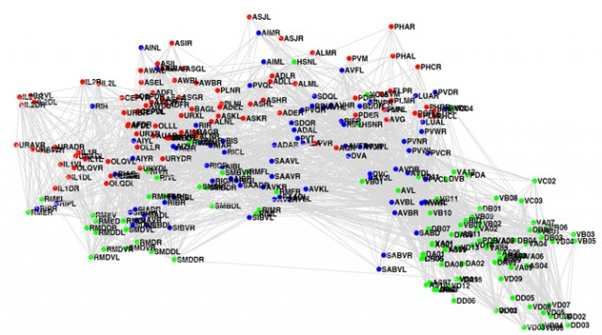

The c.elegans brain network

Slide 38
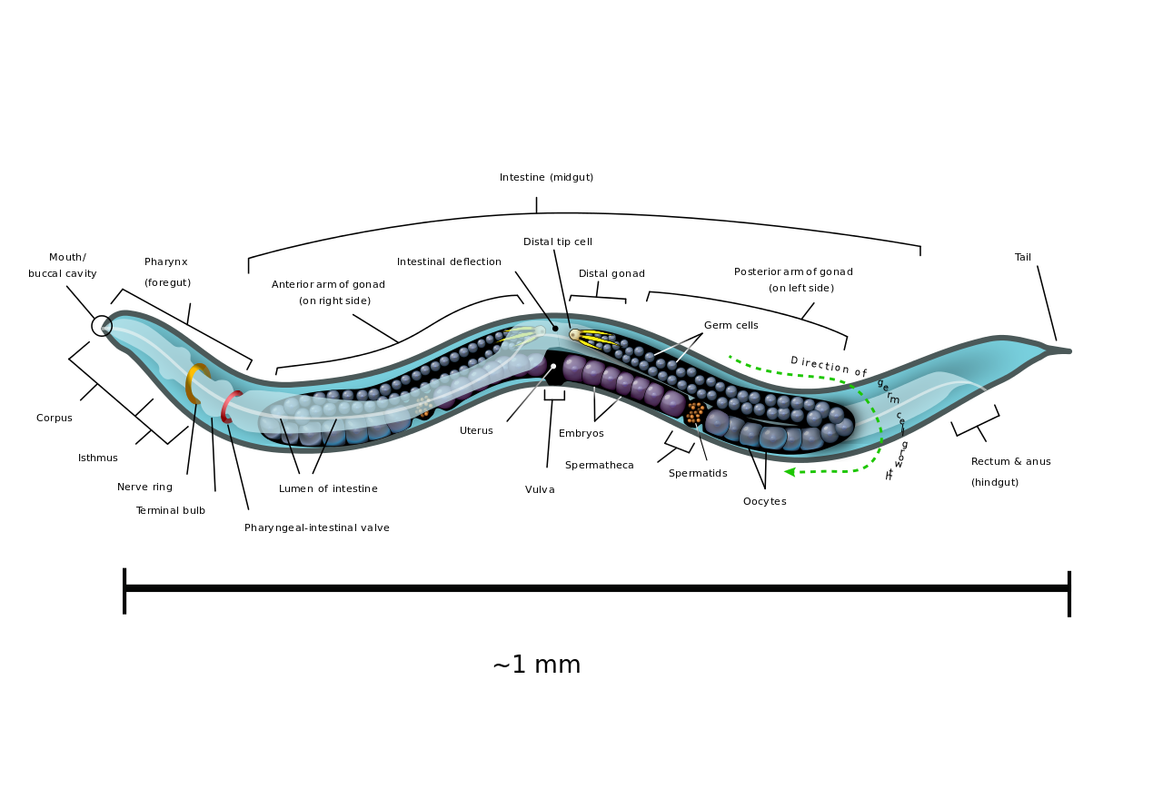
The c.elegans brain network
https://en.wikipedia.org/wiki/Caenorhabditis_elegans

Slide 39
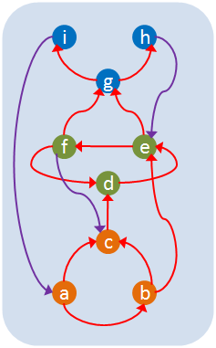
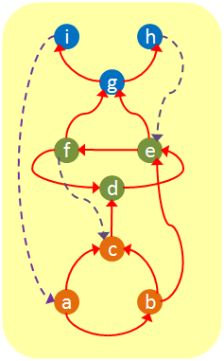
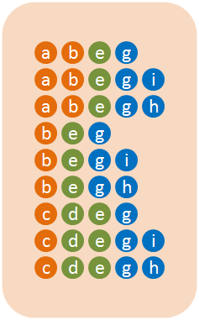
Identify feedforward paths, from sources to targets
Initial network
279 neurons
88 Sensory neurons
87 Interneurons
119 Motor neurons
2194 Directed edges (chemical synapses)
~300 feedback edges removed
(Motor to
Inter/Sensory
& Interneurons to Sensory)
9 shortest paths from all Sensory to all Motor neurons

Slide 40
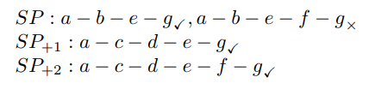
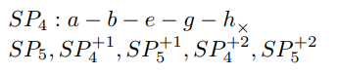
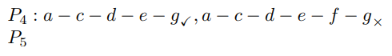
Routing strategy for path selection?
i
h
g
f
e
d
c
a
b

Slide 41


Evidence of hourglass effect

Slide 42

Core neurons are created early in development
https://www.youtube.com/watch?v=M2ApXHhYbaw

Slide 43
c.elegans core neurons
10 core neurons for SP⁺² path set, H-score: 0.85
Neuron | Rich Club? | Path Central | Cumul Coverage | Funcional Description
AVAR | Y | 0.37 | 0.41 | Driver cell for backward locomotion
AVAL | Y | 0.34 | 0.27 | Driver cell for backward locomotion
AVBL | Y | 0.18 | 0.10 | Driver cell for forward locomotion
PVCL | Y | 0.20 | 0.07 | Command interneuron for forward locomotion
PVCR | Y | 0.18 | 0.04 | Command interneuron for forward locomotion
AVER | Y | 0.12 | 0.03 | Driver cell for backward locomotion
AVBR | Y | 0.11 | 0.03 | Driver cell for backward locomotion
AVEL | Y | 0.13 | 0.03 | Driver cell for backward locomotion
AVDR | Y | 0.11 | 0.02 | Modulator for backward locomotion due to head touch
DVA | Y | 0.09 | 0.02 | Mechano-sensory integration

Slide 44
What causes the hourglass effect in designed networks?
The Reuse-Preference (RP) model

Slide 45
“Reuse-Preference” model

Slide 46
Given for each node: node rank (partial order) and in-degree
6
6
6
6
5
4
3
2
1
1
1
1

Slide 47

RP model: selection of inputs
6
6
6
6
What is the probability that node v of rank n+1 depends on node of rank x?
5
4
3
Positive alpha: prefer high rank nodes (close to node v). E.g., α = +1 for node-4
0.54
0.18
0.27
2
0.27
Negative alpha: prefer low rank nodes (near sources). E.g., α = -1 for node-4
1
1
1
1
0.55
0.18

Slide 48
α = +1
H-score = 0.5

Slide 49
α = 0
H-score = 0.25

Slide 50
α = -1
H-score = 0.0

Slide 51


Slide 52


The RP-model accurately predicts path centrality and out-degree distributions

Slide 53
What causes the hourglass effect in evolving networks?
Follow-up work by Uri Alon’s group @ Weizmann

Slide 54




Slide 55


Slide 56

The rank r of the goal matrix G is the width of the evolved network

Slide 57
How is the hourglass effect related to:
Cost?
Evolvability?
Robustness?

Slide 58
Hourglass systems and cost
m targets
m targets
k waist nodes
n sources
n sources
n*m dependencies
k*(n+m) dependencies
Hourglass-system requires fewer in-out dependencies (edges) if
k < n*m / (n+m) < min{n,m}

Slide 59
Hourglass systems and evolvability
m targets
m targets
k waist nodes
n sources
n sources
Requires m changes
Requires k changes
What if a source or target needs to be modified?
But what if the source/target relations require changes at the waist?

Slide 60
Hourglass systems and robustness
m targets
m targets
k waist nodes
n sources
n sources
What if a source/target fails?
What if a waist node fails?

Slide 61

The pros & cons of having a thin waist
Hourglass structure facilitates evolvability
Changes at lower/higher layers are easier & do not require system-wide changes
Hourglass structure provides robustness
Failure of modules at lower/higher layers are less likely to cause system-wide failures
Modules at waist persist for long time, limiting space of possible source-target dependencies: ossification
Nodes at waist are system’s greatest fragility

Slide 62
Ongoing work -
Part of DARPA’s Lifelong Learning Machines (L2M) program

Slide 63


Hourglass effect in
deep learning
Fukushima’s neocognitron
Hinton’s autoencoder
Notes:
High-dimensional data can be converted to low-dimensional codes by training a multilayer neural
network with a small central layer to reconstruct high-dimensional input vectors. Gradient descent
can be used for fine-tuning the weights in such ‘‘autoencoder’’ networks, but this works well only if
the initial weights are close to a good solution. We describe an effective way of initializing the
weights that allows deep autoencoder networks to learn low-dimensional codes that work much
better than principal components analysis as a tool to reduce the dimensionality of data.

Slide 64
Hourglass effect in multisensory integration?

Slide 65
Hourglass effect in lifelong learning machines

Slide 66
Concluding remarks
Hierarchical modularity is an important and universal property of complex systems
We showed that systems from diverse disciplines evolve to (or designed to have) a hierarchical architecture in which a small number of intermediate modules are highly central and preserved
Proposed a model to explain this phenomenon: Reuse-Preference
Connections with System Design, Cost, Evolvability and Robustness

Slide 67

Joint work with my student
Kaeser Md. Sabrin

Slide 68

and my late student Saamer Akhshabi
1 April 1987 – 6 March 2014

Slide 69


